Slide 2
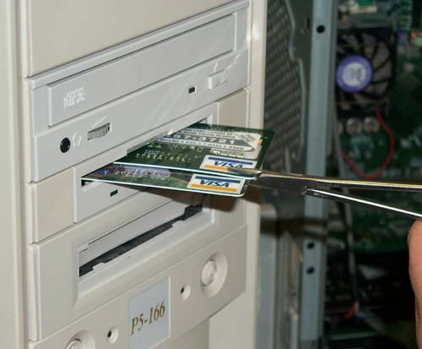

Slide 3
Agenda
Introduction
Payment gateways
Weaknesses
Attacks
Conclusion

Slide 4
Introduction

Slide 5
Introduction
A payment gateway is an e-commerce application service provider service that authorizes payments online. It is the equivalent of a physical point of sale terminal. Payment gateways protect credit card details by encrypting sensitive information, such as credit card numbers, to ensure that information is passed securely between the customer and the merchant and also between merchant and the payment processor.

Slide 6
@Wireghoul
Penetration tester
Father
Husband
Geek
Blogger

Slide 7
“Bad guys” have an end game:
Fraudulent transactions
Not paying for goods/services
Paying very little for goods/services
Steal credit cards
Always popular
Easy to convert into cash

Slide 8
Payment gateways are:
Easy to use!
Iframe shopping carts
Transaction details in url
Supports developers!
Documentation
Source code
Secure!
PCI compliant
Request Validation aka “Tamper proof”
Use SSL

Slide 9
Testing payment gateways
Out of penetration testing scope
Test data
Use test credit card numbers
VISA | 4111 1111 1111 1111
Mastercard | 5555 5555 5555 4444
American Express | 378282246310005

Slide 10
Transaction diagram
Browser
Merchant Website
Payment Gateway

Slide 11
From the trenches
What have we seen in “the wild”:
Cross site scripting
Information disclosure
Directory traversal
Negative numbers
Exposure of credit card numbers
Configuration issues
Insecure file uploads
More

Slide 12
Basic attacks
Tamper to change payment amount
Tamper to change currency
Tamper to change return url
Spoof transaction complete

Slide 13
Transaction diagram
Browser
Merchant Website
Payment Gateway

Slide 14
Basic attacks
Tamper to change payment amount
Tamper to change currency
Tamper to change return url
Spoof transaction complete
Solved with request validation

Slide 15
Vendor resources

Slide 16
Using Vendor resources
Identify vulnerabilities based on vendor resources
Documentation
Example source code
API Libraries
Shopping cart code

Slide 17
Vendor resources – Example code
<?php
/** Constants */
$customer_data_dir = "/var/tmp";
$customer_ref = $_POST["customer_ref"];
$subscription_ref = $_POST["subscription_ref"];
if($customer_ref == null) {
header("HTTP/1.0 404 Not Found");
} else {
$customer_data = fopen("$customer_data_dir/$customer_ref.txt", "w") or die("Can't open file.");
fwrite($customer_data, $subscription_ref);
fclose($customer_data);
}
?>

Slide 18
Vendor resources – Example code
<?php
/** Constants */
$customer_data_dir = "/var/tmp";
$customer_ref = $_POST["customer_ref"];
if($customer_ref == null) {
header("HTTP/1.0 404 Not Found");
} else {
unlink("$customer_data_dir/$customer_ref.txt")
}
?>

Slide 19
Vendor resources – Shopping carts
Notes:
OSVDB graph of vulnerabilities

Slide 20
Vendor resources – Shopping carts
Transaction complete with incomplete payment – (SA-CONTRIB-2010-064)
Price manipulation (OSVDB-32192, 38368, 11429, 11430, 11431 + many others)
Remote command/code execution
Authentication bypass
Customer database exposure
Abritrary file upload
Format string

Slide 21
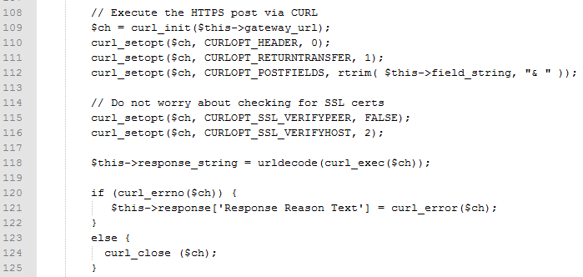
Vendor resources – Shopping carts
Use SSL … right?

Slide 22
Request validation

Slide 23
Request validation
To validate the request of the payment page result, signed request is often used - which is the result of the hash function in which the parameters of an application confirmed by a «secret word», known only to the merchant and payment gateway.
-- Wikipedia
Notes:
http://en.wikipedia.org/wiki/Payment_gateway

Slide 24
Defeating request validation
Bypass request validation
Attacking the hashing algorithm
Attack the request validation itself
Notes:
There are a few ways around the request validation,
You can bypass the validation process
You can attack the cryptographical algorithms used
You can also attack the request validation, which I will cover in detail

Slide 25
Bypassing request validation
HTTP Parameter Pollution
https://url/pay?amount=100.00&amount=0.01
Abusing unprotected parameters
https://url/pay?expiry_date=31/12/2099
Abusing application logic
https://url/pay?pre_auth=1

Slide 26
Attacking request validation
Hashing algorithm attacks
MD5 hash length attack
Hash mismatch behavior
Redirects to attacker supplied url

Slide 27
Breaking request validation
Brute force attacks
Known plaintext
Weak entropy due to text transform of secret
Can be done offline
Without completing a transaction

Slide 28
Brute force request validation - Example
SHA1 of "EPS_MERCHANTID|Password|EPS_TXNTYPE|EPS_REFERENCEID|EPS_AMOUNT|EPS_TIMESTAMP"
sha1('ABC0010|password123|0|Test Reference|100.00|20120916221931')
6bec095d6df852d236bc1985f2d5d73009af68a5

Slide 29
Brute force request validation - Example
<input hidden EPS_MERCHANT = “ABC0010">
<input hidden EPS_TXNTYPE = "0">
<input hidden EPS_REFERENCEID ="Test Reference">
<input hidden EPS_AMOUNT ="100.00">
<input hidden EPS_TIMESTAMP ="20120916221931">
<input hidden EPS_FINGERPRINT =" 6bec095d6df852d236bc1985f2d5d73009af68a5">
<input hidden EPS_RESULTURL = “https://www.merchantsite.com/”>

Slide 30
Brute force request validation - Example
Fingerprint
EPS_MERCHANTID
Password
EPS_TXNTYPE
EPS_REFERENCEID
EPS_AMOUNT
EPS_TIMESTAMP

Slide 31
Brute force request validation - Example
Fingerprint | Web form
EPS_MERCHANTID | EPS_MERCHANT
Password
EPS_TXNTYPE | EPS_TXNTYPE
EPS_REFERENCEID | EPS_REFERENCEID
EPS_AMOUNT | EPS_AMOUNT
EPS_TIMESTAMP | EPS_TIMESTAMP
 | EPS_FINGERPRINT

Slide 32
Brute force request validation - Example
Fingerprint | Web form
EPS_MERCHANTID | EPS_MERCHANT
Password
EPS_TXNTYPE | EPS_TXNTYPE
EPS_REFERENCEID | EPS_REFERENCEID
EPS_AMOUNT | EPS_AMOUNT
EPS_TIMESTAMP | EPS_TIMESTAMP
 | EPS_FINGERPRINT

Slide 33
Brute force request validation - Example
Password is usually:
Vendor supplied
User specified
No change requirements
Sometimes converted to upper/lower-case
[a-zA-Z0-9]{8}
[a-z0-9]{8}
.{8}
[0-9a-f]^32

Slide 34
Breaking request validation
Once we have broken request validation we can
Perform SQLi attack
Alter cost
Alter currency
Spoof payment received signatures

Slide 35
Breaking response validation
A string used to validate the transaction output.
SHA1 hash of:
EPS_MERCHANTID|Password|EPS_REFERENCEID|EPS_AMOUNT|EPS_TIMESTAMP|EPS_SUMMARYCODE
sha1('ABC0010|password123|Test Reference|100.00|20120916221931|1')
633c32a13e87e5f538f5521501013ffe44dc66b3

Slide 36
DEMO

Slide 37
Conclusion
Don’t rely on the browser to drive traffic between the merchant website and the payment gateway
Always validate the transaction amount and payment status in a secondary request using API before considering a transaction complete
Wait for payment to clear before shipping goods
Use more than one unknown variable in request validation
Weak request validation does not equal a vulnerability

Slide 38
Questions
???

